Slide 1
Understanding, Assessing, and Treating the /r/ Speech Sound
Dennis M. Ruscello, Ph.D.
West Virginia University
Morgantown, WV

Slide 2
Acknowledgements
The presenter is an employee of West Virginia University and was invited to present this seminar.
There are no financial relationships to declare.
There are no nonfinancial relationships to declare.

Slide 3
Overview
Most SLPs would agree that /r/ is one of the most frequent misarticulations seen in school children.
In some cases it is difficult to teach the acquisition of /r/ or correct placement.
In others, it is the automatic use of the sound in context.

Slide 4
Overview
The presentation will include the following:
Background information regarding /r/ and misarticulation of /r/.
Techniques for the acquisition of /r/.
Contextual considerations in treatment of /r/.
Incorporation of /r/ at different levels of practice.
Issues involved in treatment.

Slide 5
Background Information
The consonant /r/ is a liquid with /l/.
Liquids have distinct placements.
/r/ is produced with either tongue retroflexion or tongue bunching.
Retroflexion is curling the tip of the tongue toward the palate just behind the alveolar ridge.

Slide 6
Retroflex /r/
Retroflex /r/

Slide 7
Background Information
Bunched /r/

Slide 8
Vocalic / ɝ, ɚ/ Variants
The vocalic variants of /r/-/ɝ, ɚ/ are classified as central vowels with either a mid or high tongue position and some lip rounding. One is tense or stressed and the other lax or unstressed.
The words bird /bɝd/ and teacher /ˈtitʃ ɚ/ are examples.
The tongue positions for /r/ and the vocalic variants are similar.

Slide 10
Age of Acquisition

Slide 11
Smit, A. B., Hand, L., Freilinger, J. J., Bernthal, J. E., & Bird, A.(1990). The Iowa articulation norms project and its Nebraska replication. Journal of Speech and Hearing Disorders, 55(4), 779–798. https://doi.org/10.1044/jshd.5504.779

Slide 12
Background Information
Developmental data also indicate that normal developing children acquire /r/ and the vocalic variants differentially.
Consonant /r/ and stressed vocalic /r/ are generally acquired prior to unstressed vocalic /r/.
Undifferentiated /r/ production in preschoolers may identify children who will require future treatment.

Slide 13
Background Information
Many professionals disagree in terms of the optimum treatment time.
Some feel that preschool children should receive treatment for /r/, particularly if they are stimulable.
In most cases clients are selected on the basis of developmental norms.

Slide 14
Error Types
There are different types of errors associated with /r/.
Some individuals produce a /w/ in place of /r/, which is sometimes identified as gliding.
That is, the glide /w/ is used in place of the /r/.

Slide 15
Error Types
Some individuals produce a distorted version of the consonant /r/. It is a production that is also referred to as a derhotacized /r/.
It is thought that the individual starts from a lower than required tongue position when producing /r/, and the result is a distortion.
The production is a sound that is between the production boundaries of /r/ and /w/.

Slide 16
Error Types
The distorted /r/ production has not been studied systematically.
Do some children change from w/r to the distortion in trying to acquire correct /r/?
Do some develop the distortion rather than the w/r.
In either case, the distortion is very difficult to treat.

Slide 17
Error Types
Children will generally substitute a high lax back vowel such as / ʊ / for the tense vocalic variant.
They will also use the schwa in place of the lax vocalic variant (ɝ, schwar).
These types of sound errors are generally referred to as vocalization.

Slide 18
Error Summary
ERROR TYPES
1. Gliding of a liquid. /rʌn/→/wʌn/
2. Vocalization of the liquid /r/
/ˈtitʃɚ/→/ˈtitʃʊ/ /bɝd/→/bʊd/
3. Distortion of /r/ -derhotacized r; /r/ consonant or r-colored vowel that is lacking in r-ness (rhotic or retroflex quality); producing a sound between /r/ and /w/.

Slide 19
Review
What are the two different articulatory placements that speakers use to produce /r/ and the vocalic variants?
Which errors do children use in place of the correct target sounds?

Slide 20
Answers
The different placements are tongue bunching and tongue retroflexion.
Consonant /r/ errors.
w/r (Gliding).
Distortion (Derhoticizing).
Vocalic variants.
High back lax vowel.
Schwa.

Slide 21
Considerations in the Treatment of /r/
Does the child have the phonological representations of /r/?
Which type of treatment is most appropriate?
Phonetic Treatment.
Phonemic Treatment
What type of error is the child showing?
What are the discrimination abilities of the person?
Is it a developmental or residual error?

Slide 22
Speech Sound Disorders Definition
Speech sound disorders is an umbrella term referring to any combination of difficulties with perception, motor production, and/or the phonological representation of speech sounds and speech segments (including phonotactic rules that govern syllable shape, structure, and stress, as well as prosody) that impact speech intelligibility.

Slide 23
Speech Sound Disorders Definition
Causes of speech sound disorders include mislearning, motor-based disorders (apraxia and dysarthria), structurally based disorders and conditions (e.g., cleft palate and other craniofacial anomalies), syndrome/condition-related disorders (e.g., Down syndrome and metabolic conditions, such as galactosemia), and sensory-based conditions (e.g., hearing impairment).

Slide 24
Speech Sound Disorders Definition
Speech sound disorders can impact the form of speech sounds or the function of speech sounds.
Disorders that impact the form of speech sounds are traditionally referred to as articulation disorders.

Slide 25
Speech Sound Disorders Definition
Speech sound disorders that impact the way speech sounds (phonemes) function within a language are traditionally referred to as phonological disorders; they result from impairments in the phonological representation of speech sounds and speech segments—the system that generates and uses phonemes and phoneme rules and patterns within the context of spoken language.

Slide 26
Acquisition of the Sound System

Slide 27
Conclusion
There is general agreement in the research literature that partial or poorly constructed representations due to encoding and/or memory limitations are causal agents in explaining language impairment and speech delay.

Slide 28
Review
What is the most common cause of /r/ errors in children?
What are phonological representations?

Slide 29
Answers
The most frequent causal agent attributed to simple /r/ errors is mislearning.
Phonological representations are the characteristics of phonemes that we perceive, analyze, and store in our memory buffer.

Slide 30
Preliminaries to Treatment
We now want to shift to the treatment of /r/ errors and consider important treatment variables.
The first thing that we need to talk about is the child’s perception of the error and then plan for production of the target sound.

Slide 31
Discrimination of /r/
Prior to eliciting the sound in isolation, it is useful to evaluate the client’s external discrimination.
There are various tasks that can be used, but the perception task developed by Locke can be useful.

Slide 32
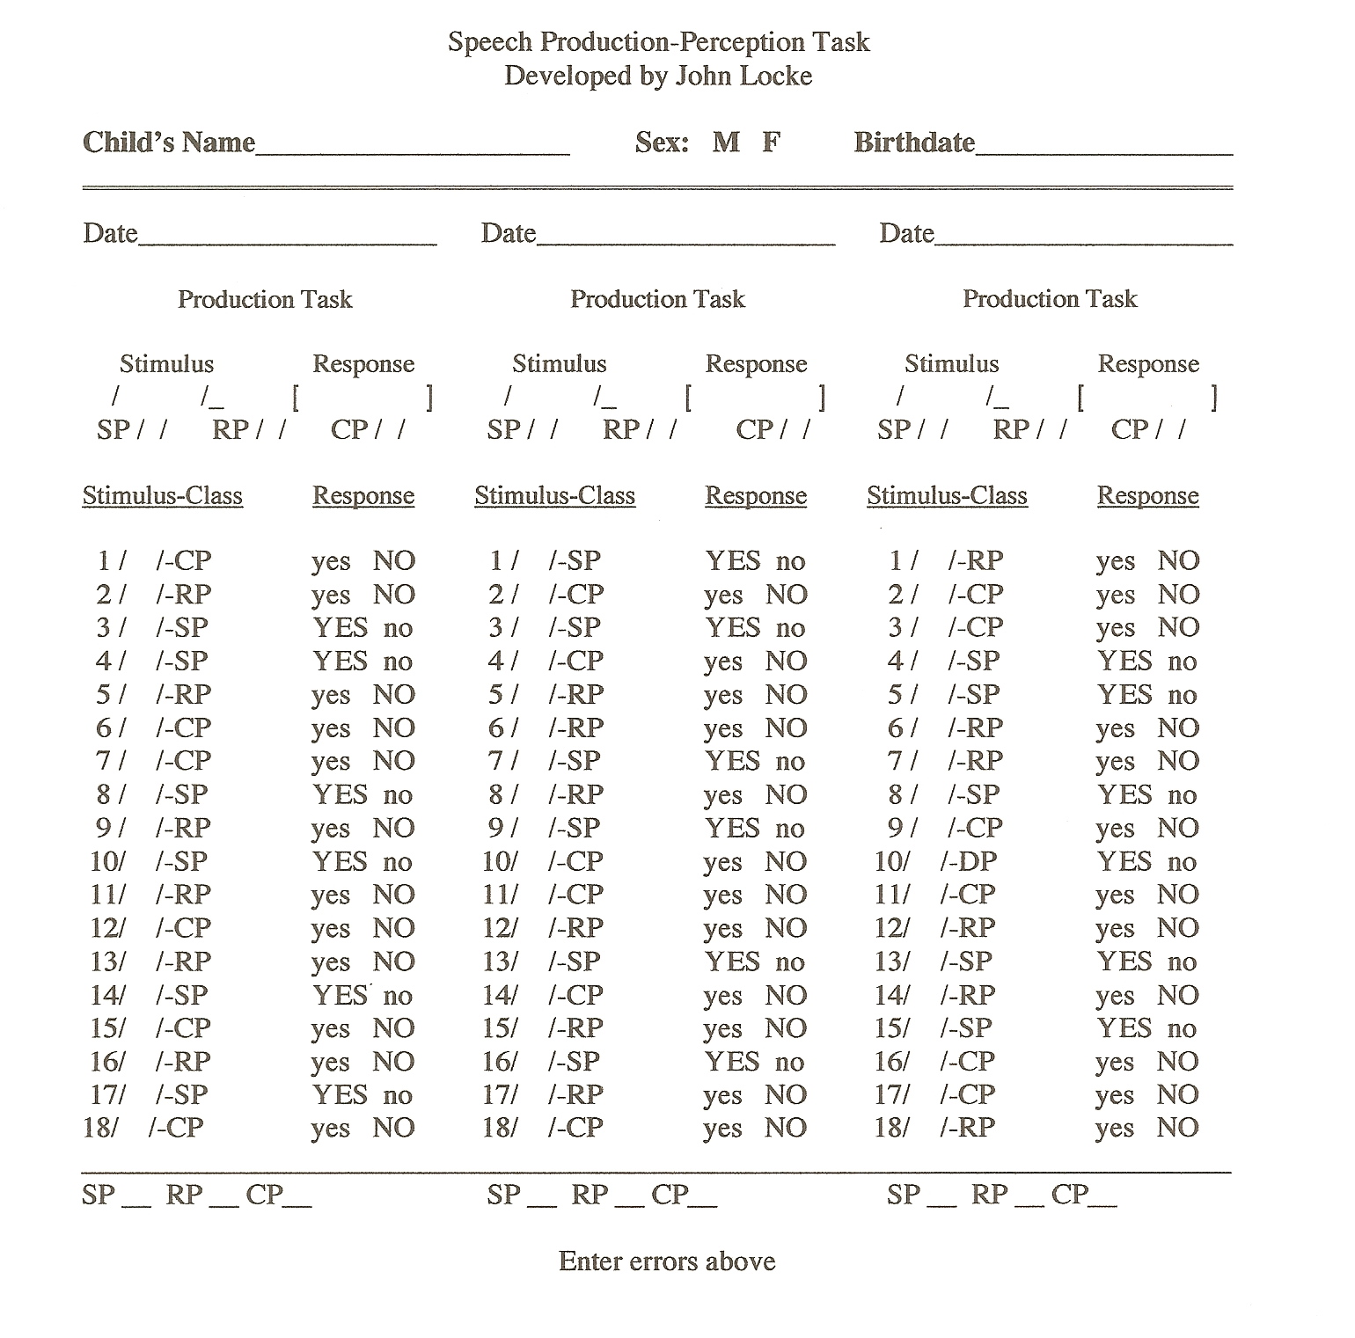

Slide 33
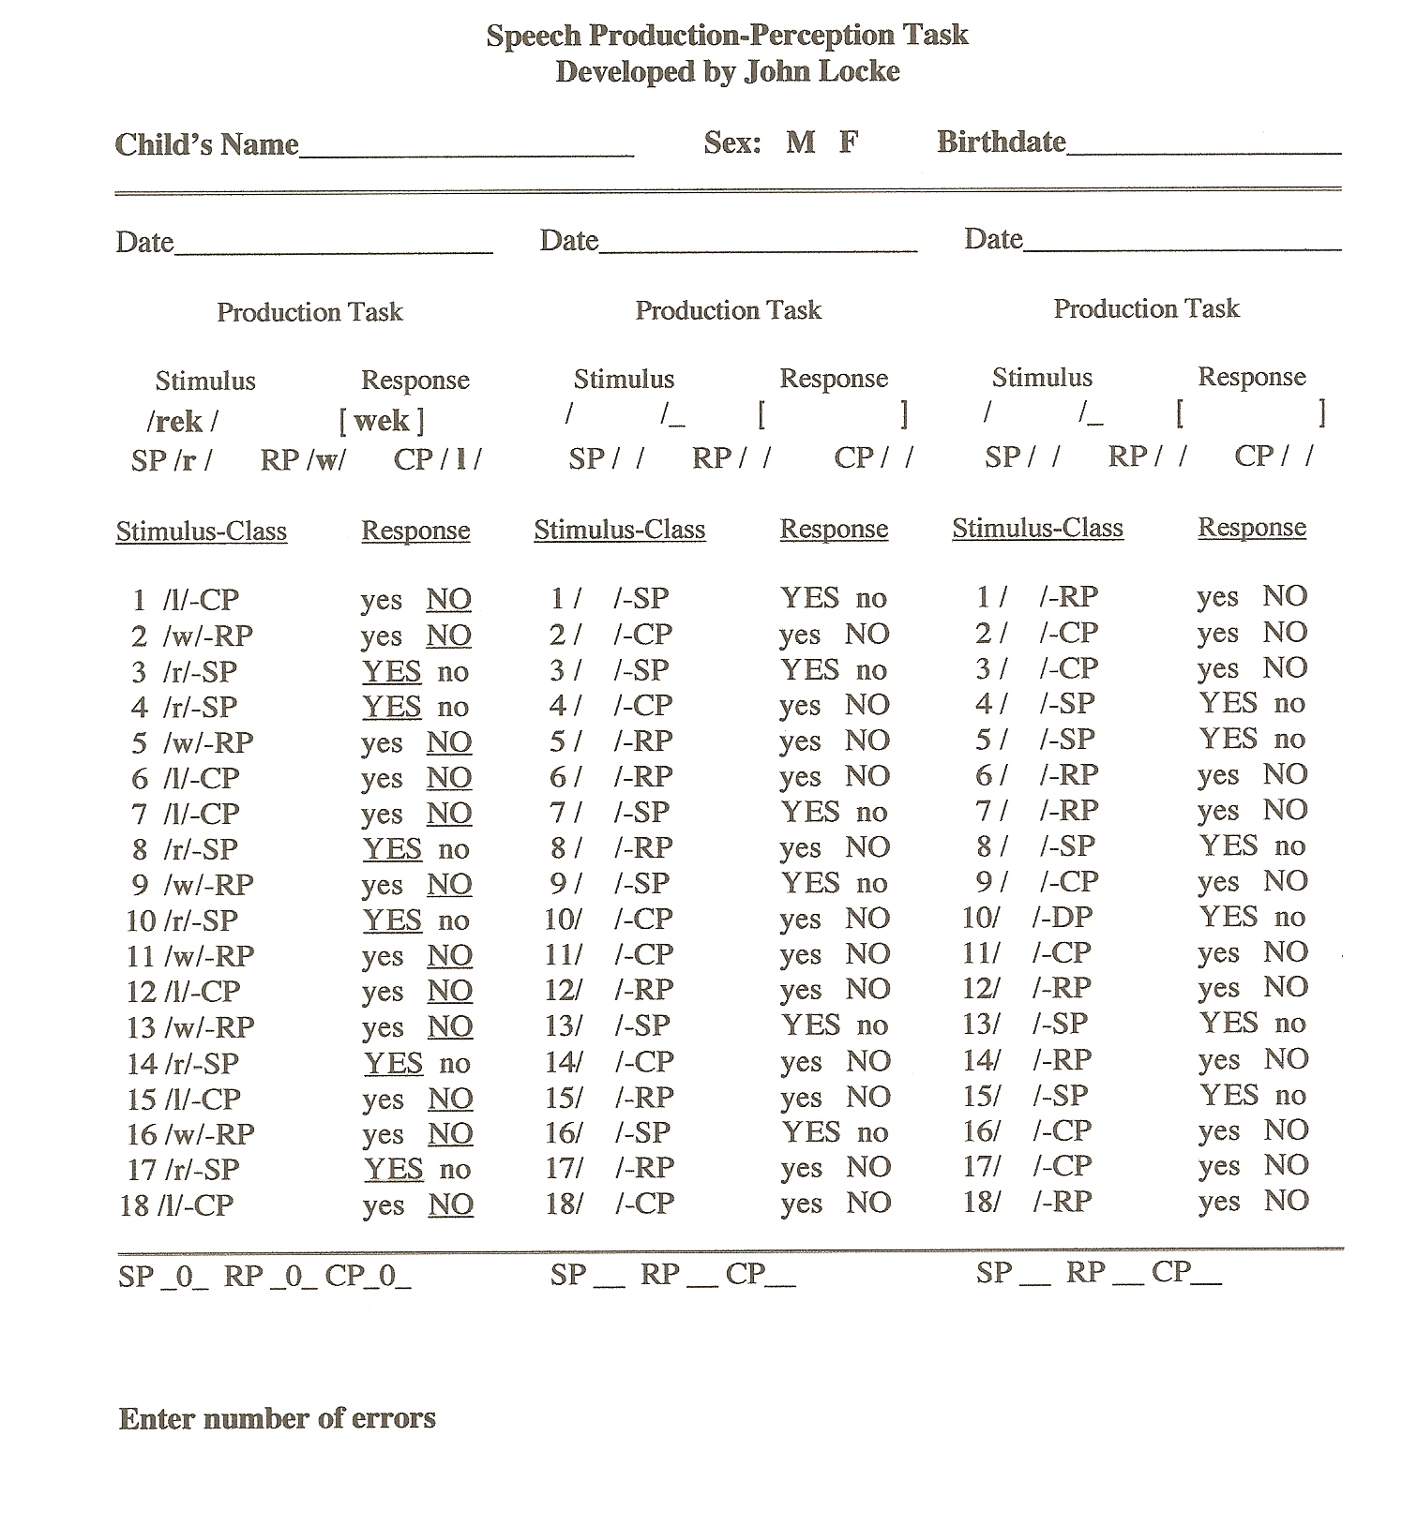

Slide 34
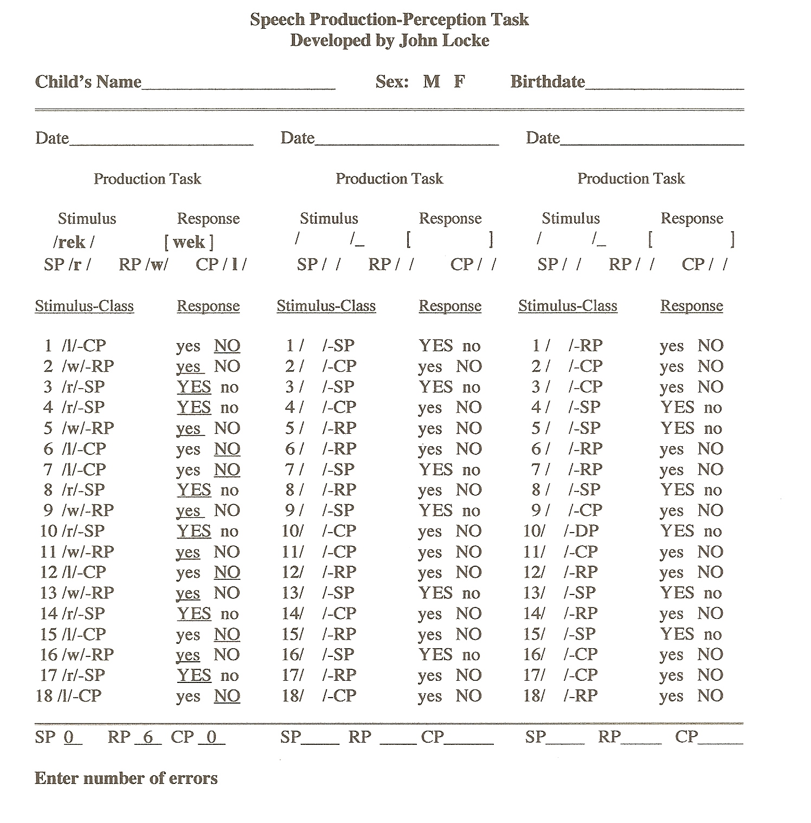

Slide 35
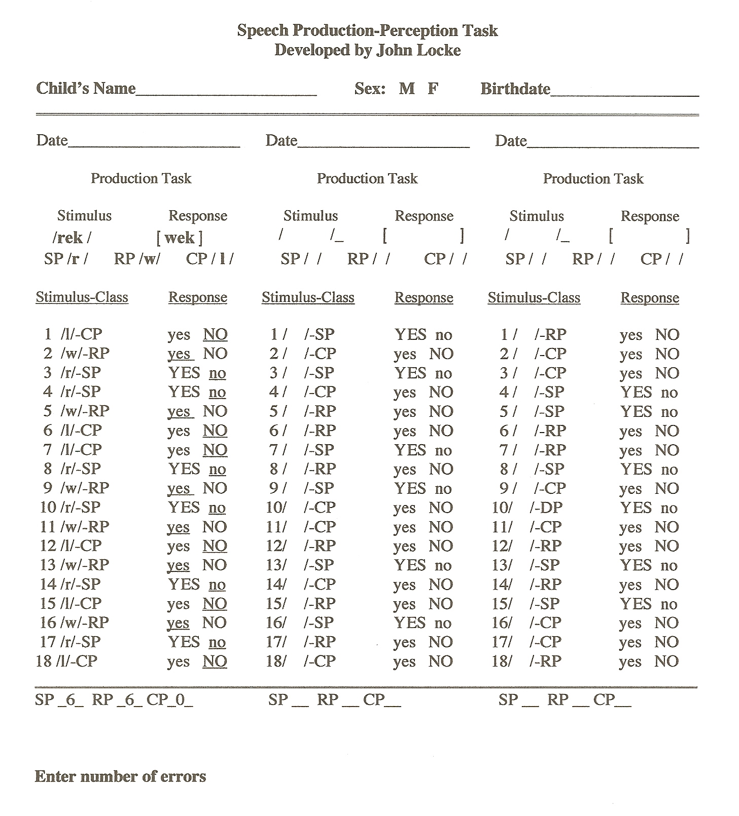

Slide 36
Understanding, Assessing, and Treating the /r/ Speech Sound
Dennis M. Ruscello, Ph.D.
West Virginia University
Morgantown, WV

Slide 37
Acknowledgements
The presenter is an employee of West Virginia University and was invited to present this seminar.
There are no financial relationships to declare.
There are no nonfinancial relationships to declare.

Slide 38
Overview
Most SLPs would agree that /r/ is one of the most frequent misarticulations seen in school children.
In some cases it is difficult to teach the acquisition of /r/ or correct placement.
In others, it is the automatic use of the sound in context.

Slide 39
Overview
The presentation will include the following:
Background information regarding /r/ and misarticulation of /r/.
Techniques for the acquisition of /r/.
Contextual considerations in treatment of /r/.
Incorporation of /r/ at different levels of practice.
Issues involved in treatment.

Slide 40
Background Information
The consonant /r/ is a liquid with /l/.
Liquids have distinct placements.
/r/ is produced with either tongue retroflexion or tongue bunching.
Retroflexion is curling the tip of the tongue toward the palate just behind the alveolar ridge.

Slide 41
Retroflex /r/
Retroflex /r/

Slide 42
Discrimination of /r/
If there is no external perception problem, begin sound elicitation.
If there is a perception problem, use discrimination training prior to sound elicitation.
Use pictures to contrast target /r/ with the /r/ substitution.
Don’t introduce production until the child can reliably discriminate correct versus incorrect.

Slide 43
/r/ Elicitation
SLPs use different methods and procedures to elicit correct motoric production of target sounds.
These methods include:
Imagery.
Imitation.
Contextual facilitation.
Phonetic placement.
Successive approximation.

Slide 44
/r/ Elicitation-Imagery
With many children, it is useful to create an image of /r/.
It can be referred to as the “pirate sound” eeeeeerrrr, or the “mad tiger sound”, or the “big dog sound.”
Imagery helps the child develop a mental anchor of the intended target sound.

Slide 45
/r/ Elicitation Imagery
In some cases, it is useful to introduce the image as making animal sounds with no initial reference to target /r/.
“We are going to make some sounds that animals make. Listen to me and make it like I do. I am making the mad tiger sound and it goes eeeeeerrrr.”

Slide 46
/r/ Elicitation Imagery
Some SLPs use the image of the sound and also pair with a manual signal. Some hand gesture is paired with the sound.
The mad tiger sound could be paired with a raised hand gesture that suggests a clawing motion as the sound is being produced.

Slide 47
/r/ Elicitation-Imitation
Imitation is generally used as an initial step in eliciting /r/ in isolation.
“Watch my mouth and listen very carefully while I make our new sound or (use image that you paired with /r/). Say eerr or rraa.”
A correct response is followed by appropriate feedback (Good) and additional practice trials.

Slide 48
/r/ Elicitation-Imitation
Additional practice trials at isolation should be conducted until the SLP feels that the child has achieved imitative control.
This step should be followed by imitative trials in CV contexts. It is recommended that a front vowel be used in the CV context.
Correct productions receive positive feedback.

Slide 49
/r/ Elicitation-Imitation
A variation of imitation is to provide the stimulation via amplification.
For example, an auditory training unit may be used for amplification thus reducing extraneous noise.
Imitative responses can also be recorded and played back for comparison purposes.

Slide 50
/r/ Elicitation-Imitation
After imitative control is achieved, practice shifts to the target in context.
The context (syllables, words) is determined by the SLP.
If the child has problems making the transition to context, introduce the stimulus shift.

Slide 51
/r/ Elicitation-Imitation
Stimulus shifting is used to strengthen an imitative response.
Steps in stimulus shift:
Present imitative trials until criterion is achieved.
Present imitative trials and pair with a graphic or pictorial representation, practice to criterion.
Present graphic representation of /r/ to elicit the target.

Slide 52
/r/ Elicitation-Context
Research indicates that perceptually correct /r/ targets may be obtained in initial position /r/ clusters.
The clusters /tr/, /dr/, and /gr/ have been identified as facilitative contexts for /r/.
It is also recommended that a front vowel be used to elicit /r/ in the prevocalic position (reed, reek, reach, etc).

Slide 53
/r/ Elicitation-Phonetic Placement
Phonetic placement cues furnish the child with cues regarding placement of the articulators.
The first example is a method that was developed by Shriberg. A wooden dowel is used to stabilize the jaw. Stabilization is thought to help facilitate tongue awareness without lip/jaw interference.

Slide 54
/r/ Elicitation-Phonetic Placement
A dowel is inserted in contact with the upper and lower molar surfaces. The client is instructed to make contact with light pressure.
Don’t provide specific instructions but let the child know that she/he can make a sound like /r/ by moving the tongue.
The idea is to let the child experiment.

Slide 55
/r/ Elicitation-Phonetic Placement
The SLP encourages the child to continue to experiment with tongue position, while models of target /r/ are produced by the SLP.
A mirror is available to show the child the contrast between a relaxed lip position for /r/ and too much rounding.

Slide 56
/r/ Elicitation-Phonetic Placement
Jaw stabilization is discontinued when the client can produce perceptually correct /r/ in CV syllables.
Another phonetic placement technique for bunched /r/ includes the following placement instructions:
Tell the child to lower the tongue tip and then raise the back of the tongue as in the production of /k/.

Slide 57
/r/ Elicitation-Phonetic Placement
When the child has achieved the tongue position, instruct the child to make sure that the sides of the tongue touch the sides of the teeth.
Then ask the child to turn on his voice motor and make the eerr sound or the rraa, whichever is preferred.

Slide 58
/r/ Elicitation-Successive Approximation
Successive approximation is shaping from one sound that the child can produce to another that the child can’t produce.
For example, have the child place the tongue tip in contact with the alveolar ridge as in production of /l/.
Have the child produce /l/ several times and then hold the /l/ position.

Slide 59
/r/ Elicitation-Successive Approximation
While holding the alveolar /l/ position, instruct the child to move the tongue tip very slowly back until it is back far enough for the tip to drop and the sound eerr is produced.
Another method is to use the high front vowel /i/ as a starting point.

Slide 60
/r/ Elicitation-Successive Approximation
Have the child produce the vowel and move the tongue back to produce the /r/.
As with all methods, instruct the child that the lateral margins of the tongue must be in contact with the sides of the molars in order to produce a correct /r/.
A third method is using the /z/ sound.

Slide 61
/r/ Elicitation-Successive Approximation
Instruct the child to produce the /z/ speech sound.
The sound is prolonged and the child is told to lower the jaw slightly and move the tongue tip back until they produce the er sound.

Slide 62
Supplemental Assistance
This was developed as a supplemental assistive tool to facilitate correct retroflex production of the /r/ speech sound.

Slide 63
Supplemental Assistance
The purpose of the Bite-r is to facilitate tongue retroflexion and tension.
It is placed between the teeth and the tongue tip is in contact with the rubber band.
Rubber Band

Slide 64
Review
If the child is not able to produce /r/ in isolation, the SLP uses different teaching techniques. What are the different teaching techniques?
What is the purpose of using imagery in treatment?

Slide 65
Review
The techniques are:
Imagery.
Imitation.
Contextual facilitation.
Phonetic placement.
Successive approximation.
Imagery helps the child develop a mental picture of the intended target sound.

Slide 66
Introduction to Principles of Treatment
A child may or may not have the underlying phonological representations of the target speech sound(s).
In our discussion we will take a phonetic-based approach.

Slide 67
Basic Components of Phonetic Treatment
The instructional event sequence in motor learning treatment plans consists of four hypothetical constructs.
A stimulus is presented to elicit a specific response.
The response is the learner’s contribution.

Slide 68
Basic Components of Phonetic Treatment
After the response, feedback is given to the learner.
The feedback consists of two types.
Intrinsic feedback.
Extrinsic feedback.
This differs from our use of operant learning theory as a teaching technology.

Slide 69
A Review of the Therapy Events

Slide 70
Let’s Think About Applying Motor Learning
The child’s job is to practice and develop the motor skills requisite for a sound or sounds.
Practice activities will differ depending on the child’s level of performance.

Slide 71
These are the Stages of Skill Development

Slide 72
What Can We Do to Assist the Child?
Since we hypothesize stages of skill development, different activities are used at different stages.
Consequently, we want to identify variables that assist in the retention and transfer of the skill(s).

Slide 73
Presentation of Stimuli
Blocked practice is an activity that involves practicing a skill in a repetitive manner. The items are practiced to a specified response criterion.
Random practice differs since the skill is practiced but the order of items is randomized; some items do not involve practice of the target.

Slide 74
Presentation of Stimuli
Studies show better retention with randomized practice as opposed to blocked practice; however, both types of practice are useful at different stages of skill development.

Slide 75
Stimuli Examples
Block Practice
1. run
2. rick
3. rope
4. rug
5. red
Randomized Practice
1. soup
2. rug
3. ten
4. rick
5. soap
6. red
7. bite
8. run
9. rope

Slide 76
Presentation of Stimuli
Variable practice involves practicing many different variations, so that the skill is carried out under a number of different conditions, similar to the actual use of the skill.
The child is required to utilize the learned motor program in combination with the motor programs for other speech sounds.

Slide 77
Presentation of Stimuli
Constant practice differs from variable practice in that only a single variation within the desired skill is practiced.
Possibly a single context might be identified that was problematic for the learner and material would be so organized.

Slide 78
Stimuli Examples
Variable Practice
1. tree
2. run
3. bar
4. rinse
5. drink
6. ear
7. harp
8. race
9. stream
Constant Practice
1. rest
2. rip
3. car
4. rust
5. risk
6. bear
7. far
8. tear
9. rasp

Slide 79
Client Practice Responses
Different practice activities may also be introduced as the skill is developed by the child.
One such activity is the use of speed drills.
The learner practices the items in training blocks that are timed by the SLP.
In each succeeding block, the time to produce the items is reduced, but the child must maintain a high accuracy rate.

Slide 80
Client Practice Responses
Another example of altering the response to stimuli is the use of an auditory masking signal.
An auditory masking signal can be delivered via head phones to minimize auditory monitoring.
Again, the purpose is to practice the skill, while minimizing reliance on auditory feedback.

Slide 81
Enhancing Intrinsic Feedback
Error recognition is very important as the child begins to acquire and automate the target sound(s).
Initially, the SLP’s feedback of production accuracy is the major form of extrinsic feedback, but self-monitoring is important as the child progresses in treatment.
Some self-monitoring tasks include: having the client monitor productions of targets in practice, identifying, discriminating, and/or monitoring the production of another speaker, and assessing her/his productions in conversational activities.

Slide 82
Summary
Motor learning theory was presented as a model for treating phonetic-based compensatory speech errors.
It was hypothesized that a learner passes through different stages of motor skill development
Different activities may be more relevant at various stages of motor learning.
The goal is retention and transfer of taught motor skills.
Reference: Ruscello, D. M. & Vallino-Napoli, L. The application of motor learning concepts to the treatment of children with compensatory speech sound errors. Perspectives, SIG 5, Speech Science and Orofacial Disorders 24, 39-47 (2014).

Slide 83
Review
What is the purpose of practice under the guise of motor learning?
What is the difference between block and random practice?

Slide 84
Answers
Practice is that activity that used to form a motor program of the target sound. The child has learned to produce the target sound and it must be incorporated into his/her memory buffer.
Both random and block practice activities are used in treatment. Random presents stimuli randomly in combination with nonstimuli items, while block consists of all items with the target.

Slide 85
A Special Case: Residual /r/ Errors
If a sound production error persists past the developmental period, it is labeled a residual error.
Residual errors may or may not have been treated.
In our case some children do not acquire correct production of /r/ and may require specialized treatment.

Slide 86
Residual Error Risk Factors
Sound error is most likely a distortion.
Limited or no treatment success after 6 months to 2 years of therapy.
Client is not stimulable for the target sound.
Special treatments for this group of patients have included biofeedback and the construction of various speech appliances among other things.

Slide 87
Residual Errors Treatment
Biofeedback is the use of a physiological signal that the client is unaware of but it can be used by the client to change performance if brought to the client’s consciousness.
Biofeedback devices include real-time sound spectrograph, palatograph, and ultrasound.

Slide 88
Biofeedback
The picture shows a client using the sound spectrograph to correct /r/. After acquiring correct production, traditional practice activities would be introduced.

Slide 89
Elements of Biofeedback
The SLP produces examples of the target and displays the biofeedback information.
The SLP then describes the production features of the target sound.
The SLP contrasts the desired target with the client’s current production.
The client is instructed to focus mentally and use the biofeedback information.

Slide 90
Elements of Biofeedback
The client then evaluates his/her productive attempt.
The SLP then evaluates the production and provides KR.
Practice continues until the target sound is acquired.

Slide 91
Abiding Issue
One of the challenges of serving children with speech sound disorders in the schools is service eligibility for single sound errors.
According to the Individuals with Disabilities Education Act, “speech-language impairment means a communication disorder, such as stuttering, impaired articulation, a language impairment, or a voice impairment, that adversely affects a child’s educational performance” (Individuals with Disabilities Education Act, 2004(c)(11)).

Slide 92
Abiding Issue
Determining the criteria for “impaired articulation,” “adverse effects,” and even “educational performance” is surprisingly complex, generating almost daily discussion among speech-language pathologists in schools about which children should be receiving treatment for speech sound disorders.
StorkeL, H. https://doi.org/10.1044/2018_PERS-SIG1-2018-0025

Slide 93
Abiding Issue
Farquharson, K. & Tambyraja, S. R. DOI: https://doi.org/10.1055/s-0039-1677761
There is a great deal of variability nationally with respect to how children with SSDs receive speech therapy.
The authors report the results of a nation-wide survey of school-based SLPs. Findings provide insight into which and how many factors SLPs report contribute to eligibility decisions, as mandatory.

Slide 94
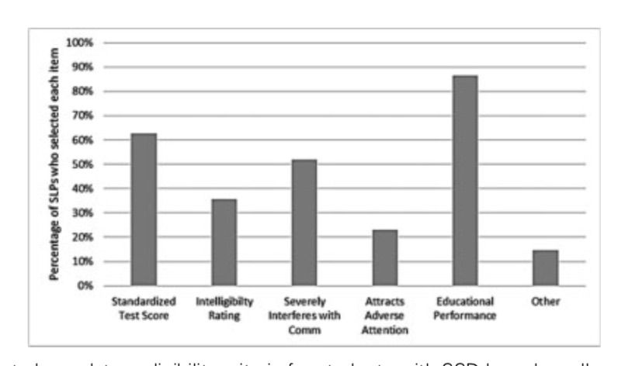
Eligibility
Mandatory Criteria

Slide 95
Eligibility
Assessment Measures Used

Slide 96
Eligibility
This is a definite issue that differs among state departments of education.
There are data that show even single errors result in less positive assessments of children with speech sound errors.
Recent reading data also show that some children with single sound errors experience reading problems, hence the need for speech treatment.

Slide 97
Glossary
Retroflex-raising the body of the tongue toward the palate and bending or curving the tongue tip upward and backward.
Rhoticized-indicates r-coloring such as ‘fear’, ‘bear’, etc.
Vocalization-a phonological process where a vowel is used in place of a liquid.

Slide 98
Glossary
Bunched-raising and arching the tongue when articulating a sound such as /r/
Liquid-classification of /r/ and /l/, reflects the production characteristics of lateral /l/ and either retroflex or bunched for /r/.
Distorted /r/-a sound used in place of /r/ that shares some acoustic features of /r/ and /w/.

